Slide 1
Self-Stigma, Self-Esteem and Symptom Severity in Trichotillomania and Skin-Picking Disorder.
Anastasia Denholm
Supervised by Dr Jude Stevenson

Slide 2
Background
What are body-focused repetitive disorders?
- Skin-picking; hair-pulling; cheek-biting; lip-biting
- Functional impairment
- High comorbidity
Self-stigma
- Associated with low self-esteem
- Prevalence in mental disorders
- Impact of high self-stigma

Slide 3
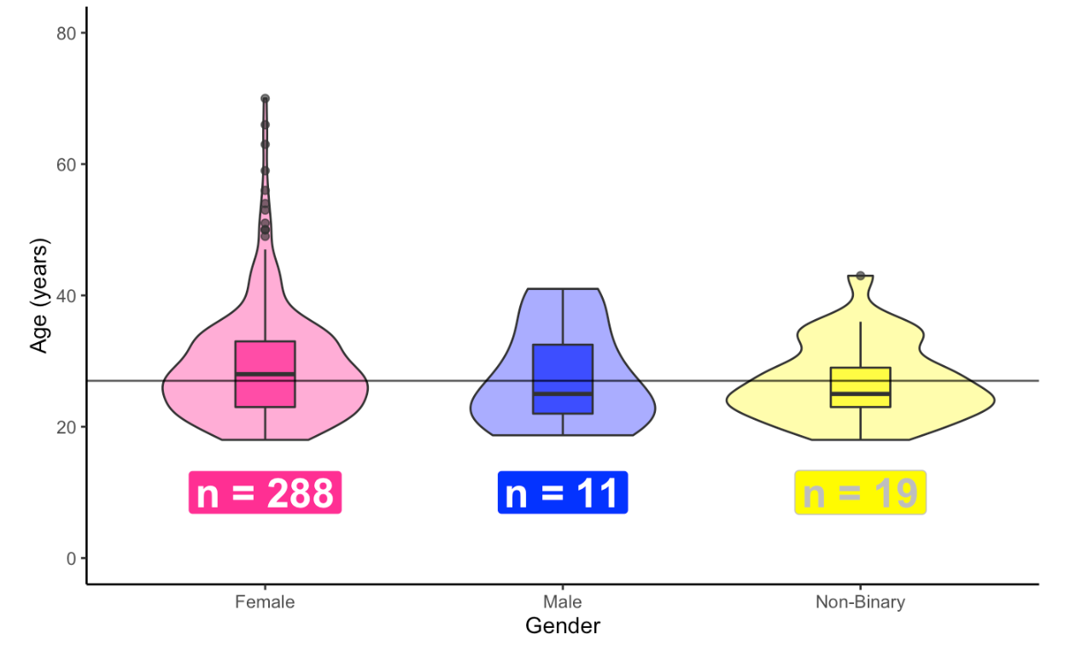
Sample & Measures
-Trichotillomania (n = 45)
-Skin-picking disorder (n = 217)
-Comorbid (n = 66)
-Massachusetts General Hospital Hairpulling Scale (MGH-HS; Keuthen et al., 1995)
-Skin-Picking Scale Revised (SPD-R; Snorrason et al., 2012)
-Internalised Stigma of Mental Illness Scale (ISMI-10; Boyd et al., 2014)
-Rosenberg Self-Esteem scale (RSE; Rosenberg, 1965)

Slide 4
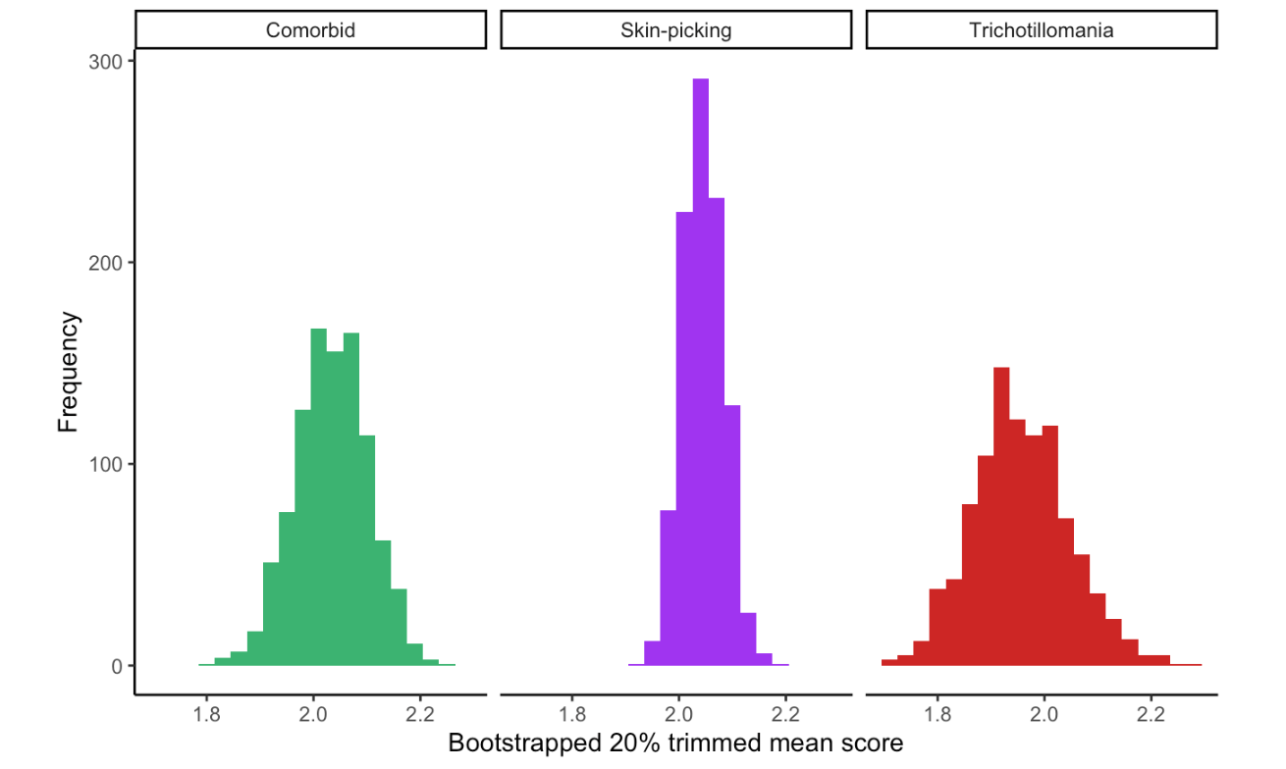
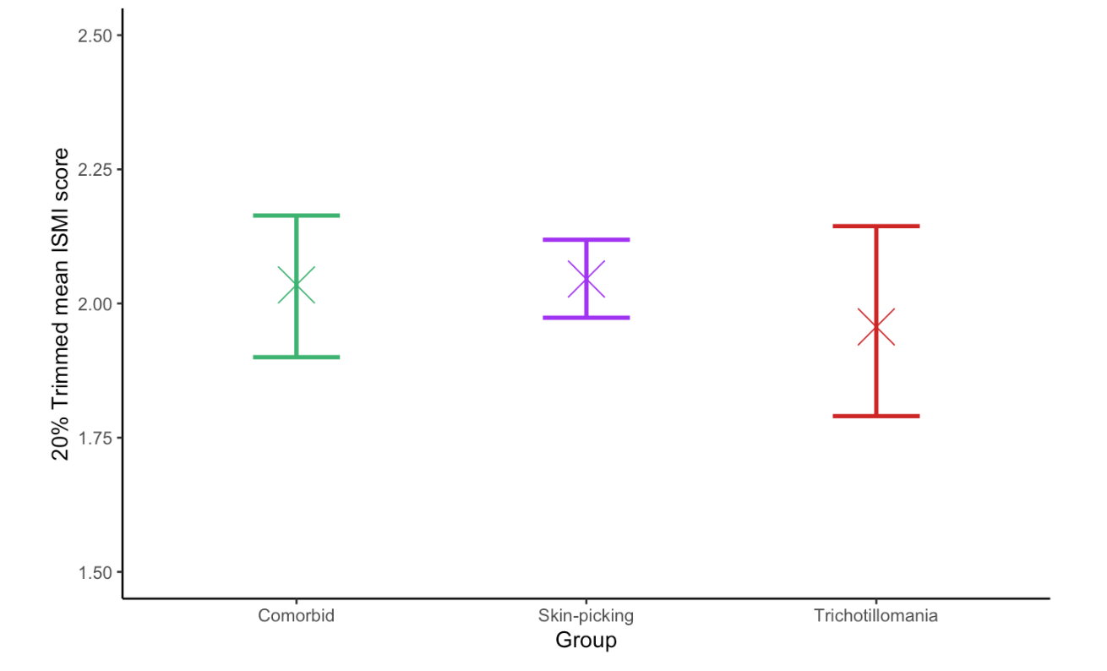
Results - Prevalence of Self-Stigma
-Estimates for the 20% trimmed mean level of self-stigma in each group

Slide 5
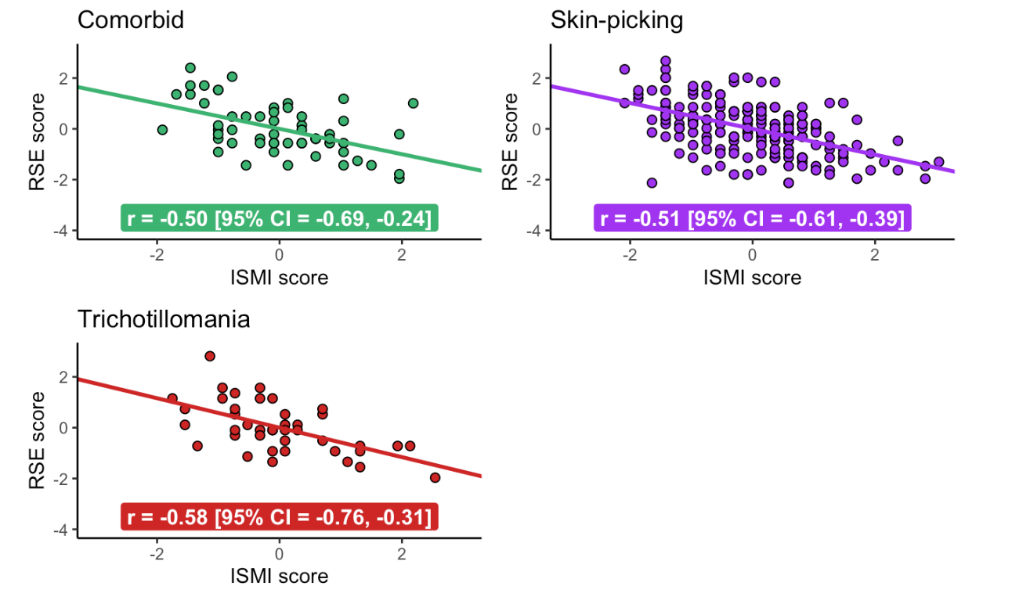
Results – Spearman’s Correlation Between Self-Stigma and Self-Esteem

Slide 6
Conclusions
Is there self-stigma in BFRBs?
What do these results indicate?
Limitations
Future directions

